Slide 1
AI for Sustainability & Green Skills
Name: Prashant Patil Enrollment: 230490131086 Stream: B.E. CSE
College: SNPIT

Slide 2
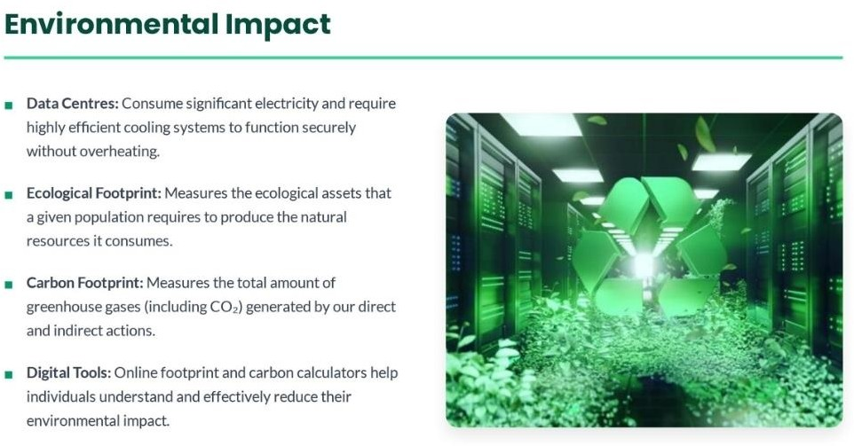
What I Learned

Slide 3
Learning From Given Resources
Data centres consume large amounts of electricity and water.
Carbon footprint calculators help measure CO₂ emissions.
Transport choices affect greenhouse gas emissions.
AI can improve waste management through smart bins.
Green skills are important for creating a sustainable future.
SDG 17 encourages partnerships to achieve global sustainability goals

Slide 4
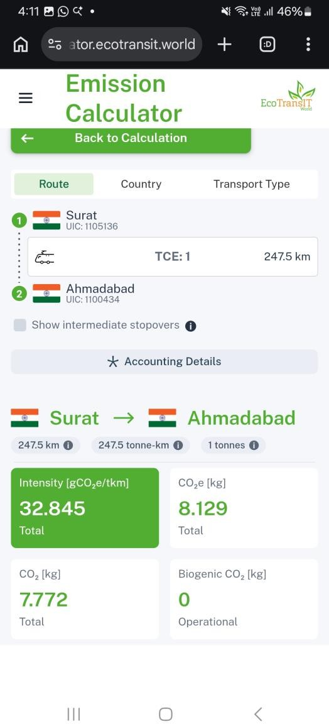
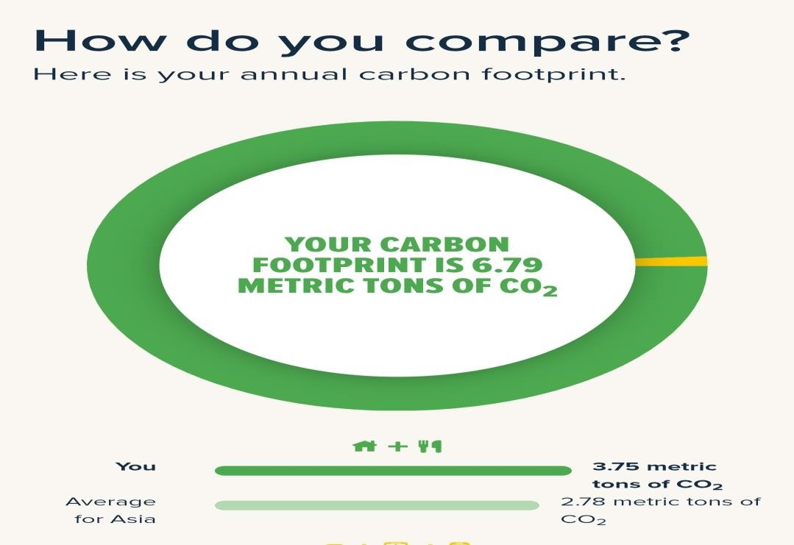
Activities
Explored ecological footprint calculator
Carbon calculator
EcoTransit emission calculator
MIT En-ROADS simulator

Slide 5
Green Skilling & AI
Green Skilling
Developing skills that help protect the environment.
Sustainability
Using resources responsibly to meet present and future needs.
AI Benefits
Smart waste segregation
Energy optimization
Pollution monitoring Climate prediction
Challenges
High energy use in AI data centres Electronic waste
Carbon emissions from AI infrastructure

Slide 6

Capstone Project
Project Title: Carbon Footprint Calculator Using Python
Problem: Calculates the CO₂ emissions generated from daily activities. Objective: Develop a simple Python application to estimate carbon footprint and promote eco-friendly habits.
Outcome: Helps users reduce carbon emissions and supports sustainable living.

